Slide 1

Automata Theory Lecture: 11 Kleene’s Theorem Part 3
Farhad Muhammad Riaz

Slide 2
NFA with Null Transition
How to Convert it into DFA
How to use the Transition Table to convert the NFA into DFA

Slide 3
Statement
If the language can be expressed by a RE then there exists an FA accepting the language.
As the regular expression is obtained applying addition, concatenation and closure on the letters of an alphabet and the Null string, so while building the RE, sometimes, the corresponding FA may be built easily

Slide 4
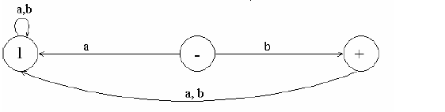
Example
Consider the language, defined over ∑ = {a,b}, consisting of only b

Slide 5
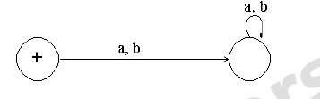
Example
Consider the language, defined over ∑ = {a,b}, consisting of only Null

Slide 6
Union of two FAs
Let FA3 be an FA corresponding to r1+ r2, then the initial state of FA3 must correspond to the initial state of FA1 or the initial state of FA2.
Since the language corresponding to r1+ r2 is the union of corresponding languages L1 and L2, consists of the strings belonging to L1or L2 or both, therefore a final state of FA3 must correspond to a final state of FA1 or FA2 or both.
Since, in general, FA3 will be different from both FA1 and FA2, so the labels of the states of FA3 may be supposed to be z1,z2, z3, …, where z1 is supposed to be the initial state. Since z1 corresponds to the states x1 or y1, so there will be two transitions separately for each letter read at z1.
It will give two possibilities of states either z1 or different from z1. This process may be expressed in the following transition table for all possible states of FA3.

Slide 7
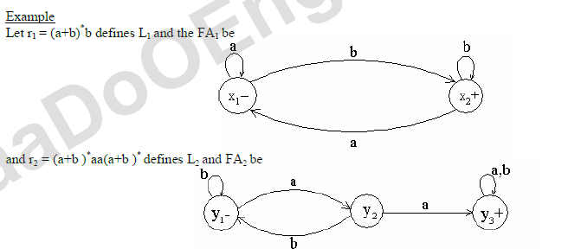
Example

Slide 8
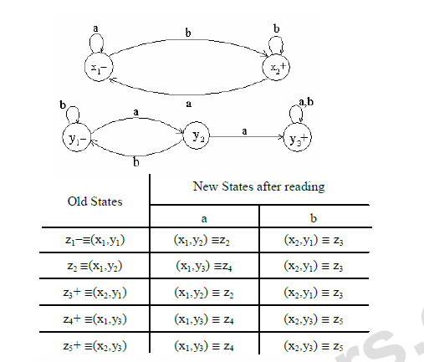
Example

Slide 9
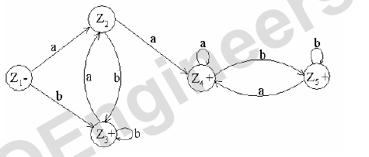

Example

Slide 10
Concatenation of two FAs
Let FA3 be an FA corresponding to r1r2, then the initial state of FA3 must correspond to the initial state of FA1 and the final state of FA3 must correspond to the final state of FA2.
Since the language corresponding to r1r2 is the concatenation of corresponding languages L1 and L2, consists of the strings obtained, concatenating the strings of L1 to those of L2 , therefore the moment a final state of first FA is entered, the possibility of the initial state of second FA will be included as well

Slide 11


Example
Let r1 = (a+b)* b defines L1 and FA1 be
and r2 = (a+b )* aa (a+b )* defines L2 and FA2 be

Slide 12
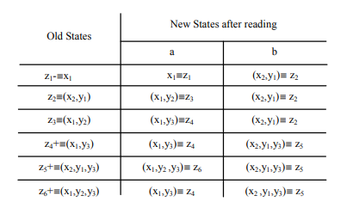
Example

Slide 13
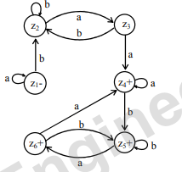
Example

